Slide 1
Reliable, Repeatable, & Automated
PowerShell for DBAs
Rob Sewell, MVP, DBA
Chrissy LeMaire, MVP, DBA

Slide 3

Community Corner
*Note – Community Corner has not and never will be “in the corner” !

Slide 4

Rob Sewell
Sewells Consulting Limited
PowerShell Automator, PowerShell Trainer, Database DevOps
MVP, Speaker and Organizer
Half a Best Speaker!!, PowerShell and SQL user groups, national and international events
Consultant, Sewells Consulting Ltd
dbatools dbareports dbachecks
Loves Pester. Always available for help via the usual social media channels
/in/robsewellsqldba
@sqldbawithbeard
robsewell.info
Notes:
This is Rob He runs his own company providing PowerShell magic, PowerShell Training and Database DevOps consultancy he’s a speaker and organiser for SQL South West, SQL Saturday Exeter, PSDayUK, PSConf.eu, PSConfasia and conference volunteer at SQL Bits

Slide 5

Chrissy LeMaire
SQL Data Pro – Since 1999
DBA, Developer and Architect
PowerShell MVP – Since 2015
Most PowerShell work revolves around SQL Server with a bit of VMware & SharePoint
Sr. Systems Engineer
GDIT @ NATO Special Ops HQ
Best Speaker & Best Lightning Talk - #SqlSatDublin
Best Speaker with dbatools teammate Rob Sewell
/in/chrissylemaire
@cl
netnerds.net

Slide 6
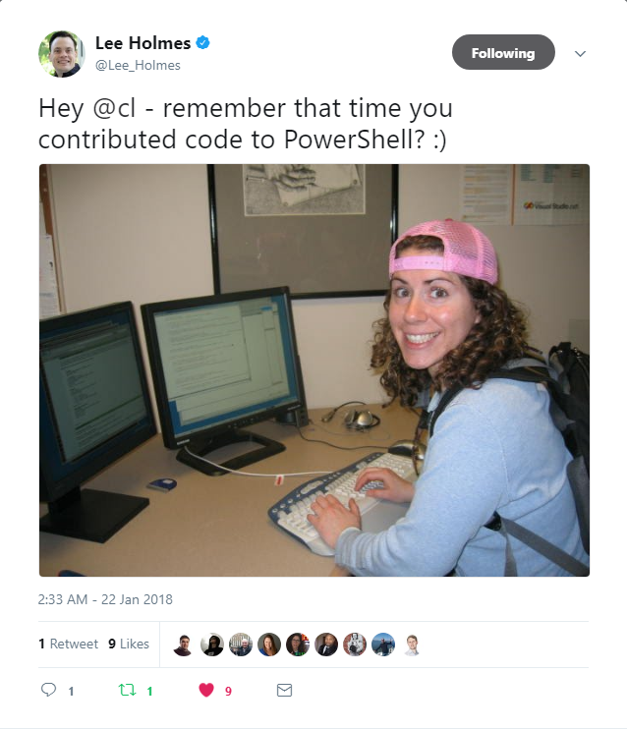
PowerShell since 2005
❤️

Slide 7

Join our Slack channel
Invite yourself to Slack
dbatools.io/slack
Join #dbachecks and #dbatools
Ask questions, possibly get answers in real time ;)

Slide 8
Agenda, before lunch
What we are aiming to solve
Orientation
PowerShell
Remoting & security
dbatools
Pester

Slide 9
Agenda, after lunch
Get-Started on your Pester Journey
Crowdsourced Pester Test Writing
Tools we use
Introducing the dbachecks module
Q & A

Slide 10
Problems we’re aiming to solve
Reduce Hesitations about PowerShell
Increase Confidence about Script Development
Whether it’s about security concerns or feeling like PowerShell is too different or hard
You’ve got a whole community that’s excited to help!
Encourage Community Contributions
Induce Excitement about Testing
Join Microsoft and the community in the global open source movement
It may be a challenge, but we’re up for it!

Slide 11

Orientation

Slide 12
PowerShell Orientation

Slide 13
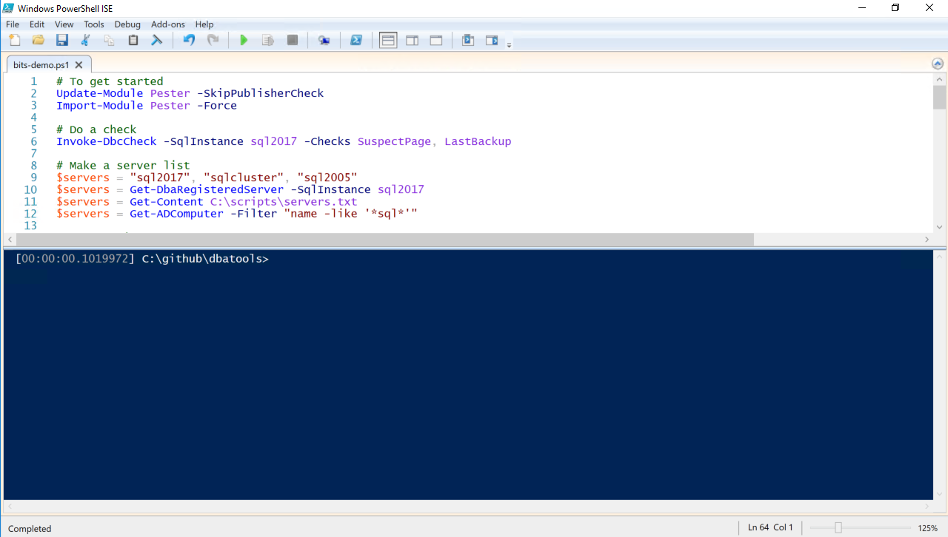
IDE Intro – Microsoft PowerShell ISE

Slide 14
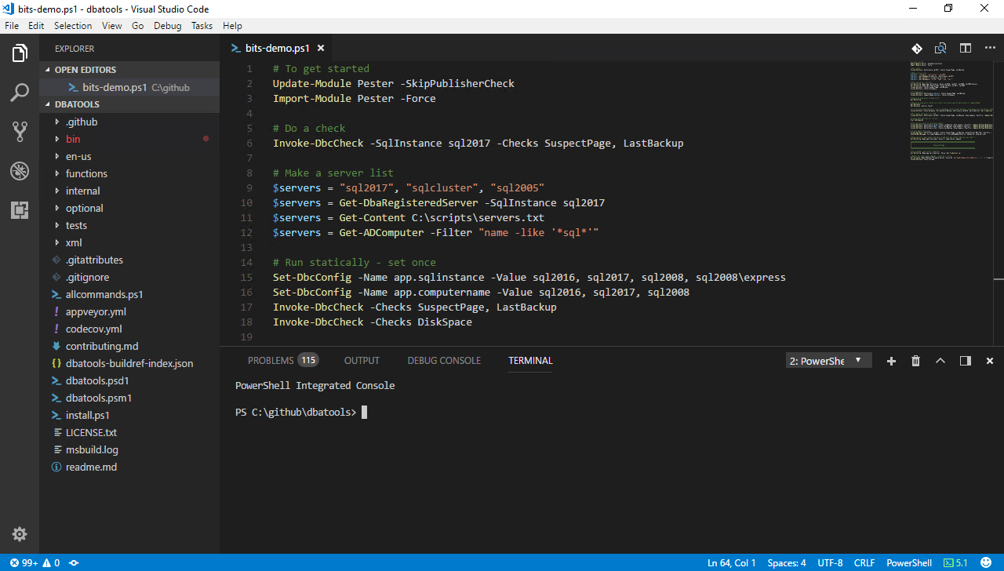
IDE Intro – Microsoft VS Code

Slide 15
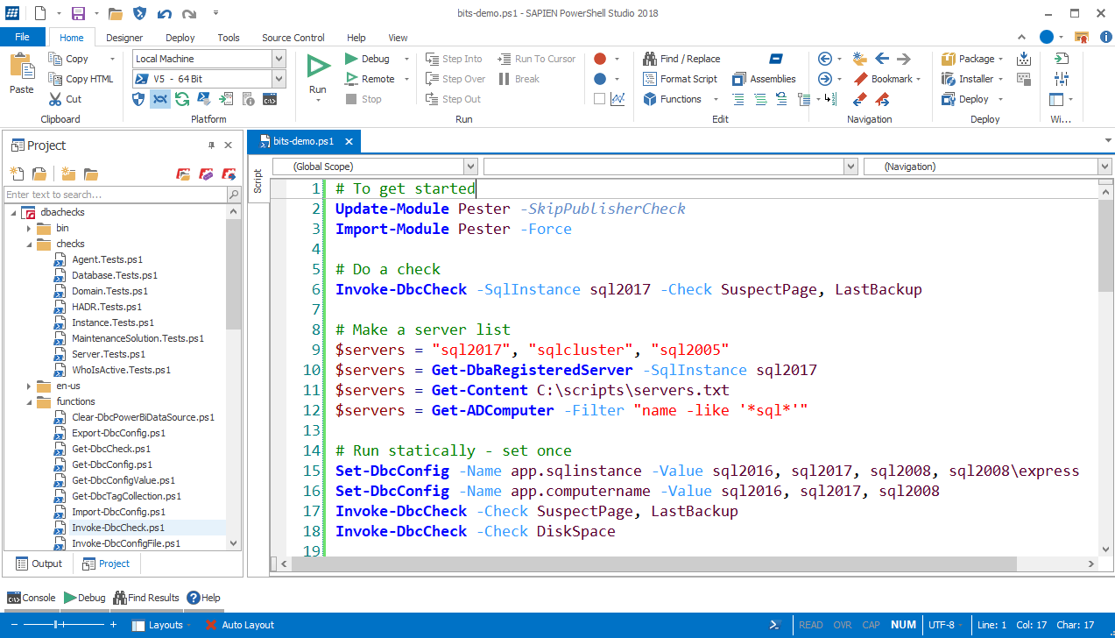
IDE Intro – Sapien PowerShell Studio
Notes:
Note PSS highlights invalid syntax

Slide 16

PowerShell Remoting & Security
Notes:
https://www.youtube.com/watch?v=BIwe571zcWY
The Little JPEG that Could Hack Your Organization w Marcus Murray

Slide 17
PowerShell Remoting
Windows PowerShell supports remote computing by using various technologies, including WMI, SQL WMI, RPC, SSH & and WS-Management
Some commands require no remote configuration, including
Restart-Computer
Test-Connection
Get-HotFix
Get-Process
Get-Service
Get-WinEvent
“Remoting” refers to commands that use WS-Management
Notes:
https://docs.microsoft.com/en-us/powershell/scripting/core-powershell/running-remote-commands?view=powershell-5.1

Slide 18
PowerShell Remoting (WS-Management)
Microsoft’s recommended way to manage Windows
By default, only allows connections from members of the Administrators group
Single port 5985 or 5986
Uses the Web Services for Management (WS-Management) protocol
Regardless of the transport protocol used (HTTP or HTTPS), PowerShell Remoting always encrypts all communication after initial authentication with a per-session AES-256 symmetric key
Initial authentication is NTLM, Kerberos and Certificates so no credentials are ever exposed
Notes:
Centralized admin
https://docs.microsoft.com/en-us/powershell/scripting/setup/winrmsecurity?view=powershell-5.1
https://blogs.technet.microsoft.com/ashleymcglone/2016/06/29/whos-afraid-of-powershell-security
https://github.com/psconfeu/2017/tree/master/David%20das%20Neves/PSConfEU17_Security_Preconf
https://blogs.msdn.microsoft.com/daviddasneves/2017/05/25/powershell-security-at-enterprise-customers/
https://vimeo.com/17649459

Slide 19
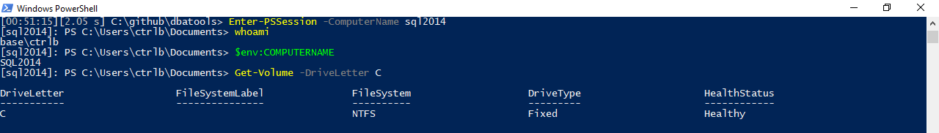
PowerShell Remoting
Notes:
Windows PowerShell supports remote computing by using various technologies, including WMI, RPC, and WS-Management.

Slide 20
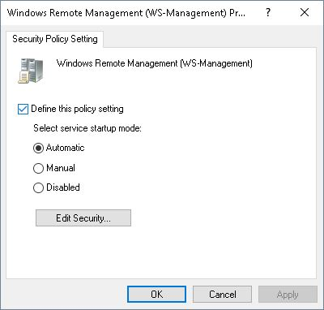
PowerShell Remoting
Enable-PSRemoting
winrm quickconfig
Via Group Policy Objects
Notes:
https://4sysops.com/archives/enable-powershell-remoting/

Slide 21
Remoting Setup
sqlps.io/remoting
Notes:
See a dude own a DC thru jpg, sql server and a stolen token

Slide 22
Real-world ownership
sqlps.io/owned
Notes:
See a dude own a DC thru jpg, sql server and a stolen token

Slide 23
PowerShell Security

Slide 24
PowerShell Security
“Secure by Design”

Slide 25
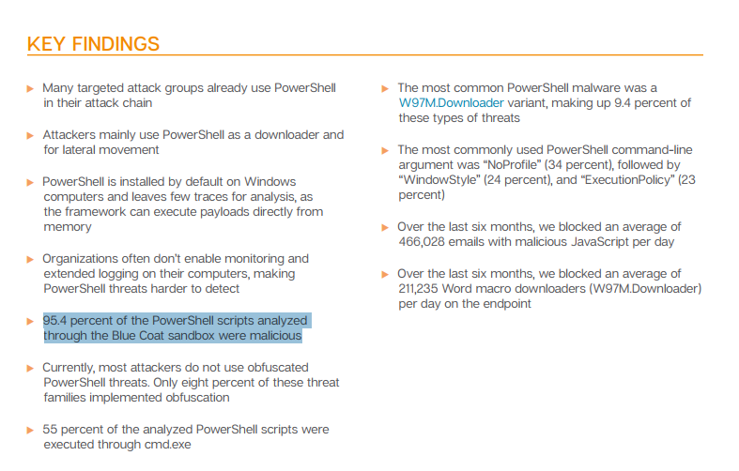
FUD in the Media
🙄
Notes:
https://www.symantec.com/connect/blogs/powershell-threats-surge-954-percent-analyzed-scripts-were-malicious

Slide 26
FUD in the Media
“AV, they love to talk about ransomeware attacks that use PowerShell, and the reason they do this is because they literally can’t keep up with the plain old stuff like exes. But they also do this because we as a community encourage it. We blog it, we tweet about it, we talk about it. And the next thing you hear is that there’s a PowerShell problem. They don’t seem to ask how to solve their C++ problem or their darn x64 problem.” ~ Lee Holmes, DerbyCon 2016 Keynote
Notes:
https://www.youtube.com/watch?v=BMreZZ1cgFI
https://docs.microsoft.com/en-us/powershell/scripting/setup/winrmsecurity?view=powershell-5.1
https://blogs.technet.microsoft.com/ashleymcglone/2016/06/29/whos-afraid-of-powershell-security
https://github.com/psconfeu/2017/tree/master/David%20das%20Neves/PSConfEU17_Security_Preconf
https://blogs.msdn.microsoft.com/daviddasneves/2017/05/25/powershell-security-at-enterprise-customers/

Slide 27
Context
”When security researchers leverage PowerShell, it is always in a post-compromise context. They have compromised a machine through some other avenue (phishing, SQL injection, etc.), and ultimately have the choice of any number of tools on the system. They were able to accomplish their goals before PowerShell, and will be able to accomplish their goals without PowerShell.”
~ Lee Holmes, Principal Security Architect
Notes:
https://blogs.msdn.microsoft.com/powershell/2016/09/27/powershell-security-at-derbycon/

Slide 28
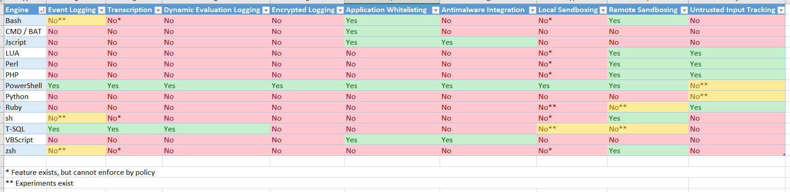
Logging
Notes:
Assume breach
Rob’s slide
https://blogs.msdn.microsoft.com/powershell/2017/04/10/a-comparison-of-shell-and-scripting-language-security/
Event Logging – The engine logs audit events of important operational events.
Transcription – The engine logs application inputs and outputs.
Dynamic Evaluation Logging – The engine logs the content of all content evaluation, including those generated or composed at runtime.
Application Whitelisting – The engine allows enforcement of code integrity / application whitelisting policies, including user-authored documents / scripts.
Antimalware Integration – The engine actively integrates with antimalware software to evaluate the safety of code generated at runtime.
Local Sandboxing – The engine allows sandboxing of behavior for local and interactive use.
Remote Sandboxing – The engine allows sandboxing of behavior when accessed remotely.
Untrusted Input Tracking – The engine allows script developers to track and make security decisions based on whether a variable or input was influenced by user input.

Slide 29
PowerShell Security In-Depth
sqlps.io/secure
Notes:
“The security argument for PowerShell is not that it's impenetrable, but that the API is designed with security in mind, and the PowerShell team itself has an impressive turnaround time when it comes to mitigating vulnerabilities. Ultimately, a quick and measured response is better than believing in total security.”
~ Mathias Jessen, @iisresetme

Slide 30
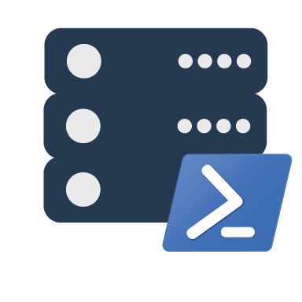
dbatools orientation
the community module
Notes:
Intro to dbatools

Slide 31
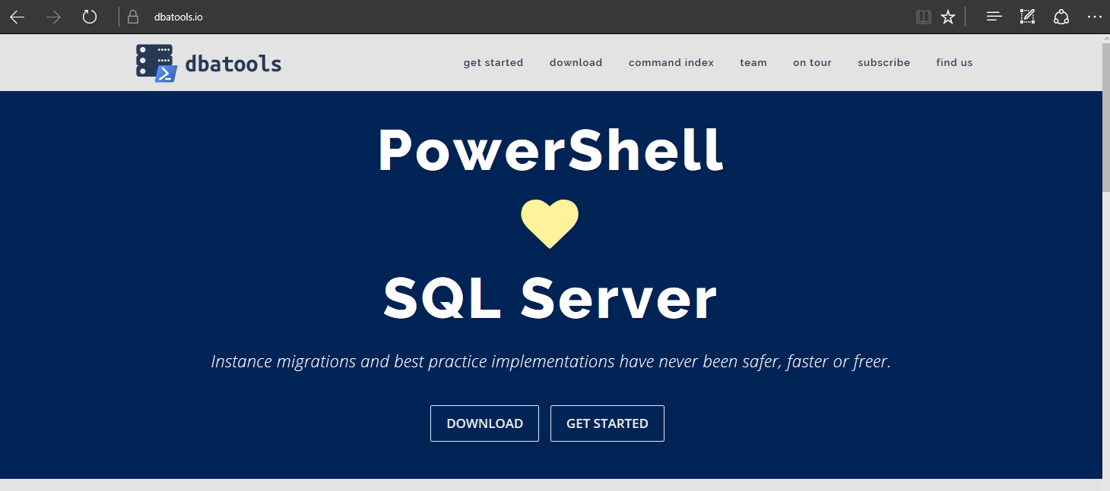
dbatools

Slide 32
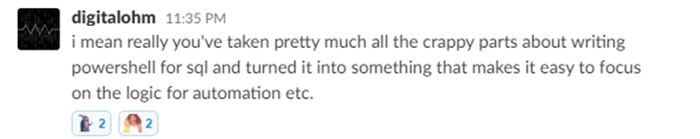
Basically..

Slide 33
Support
SQL Server 2000 – 2017 *
Express – Enterprise Edition
Clustered and stand-alone instances
Windows and SQL authentication
Default and named instances
Multiple instances on one server
Notes:
* Azure

Slide 34
System Requirements
MINIMUM
RECOMMENDED
Client
PowerShell v3
Server
SQL Server 2000
No PowerShell for pure SQL commands
Remoting enabled for Windows commands
Client
PowerShell v5.1
Server
SQL Server 2008 R2+
Notes:
SQL Server 2000 – think “Can SSMS connect?”

Slide 35
Install is easy
POWERSHELL GALLERY
Install-Module dbatools
Install-Module dbatools –Scope CurrentUser
GITHUB
Invoke-Expression (Invoke-WebRequest dbatools.io/in)
WEBSITE
dbatools.io/download

Slide 36
Need an offline install?
dbatools.io/offline

Slide 37
Now, to Import
After installing, you must import the module
Import-Module dbatools
Module manifest vs. Script module
psd1 – module manifest
formal, explicit
psm1
more informal, all functions are imported
Notes:
Speaking of functions!

Slide 38

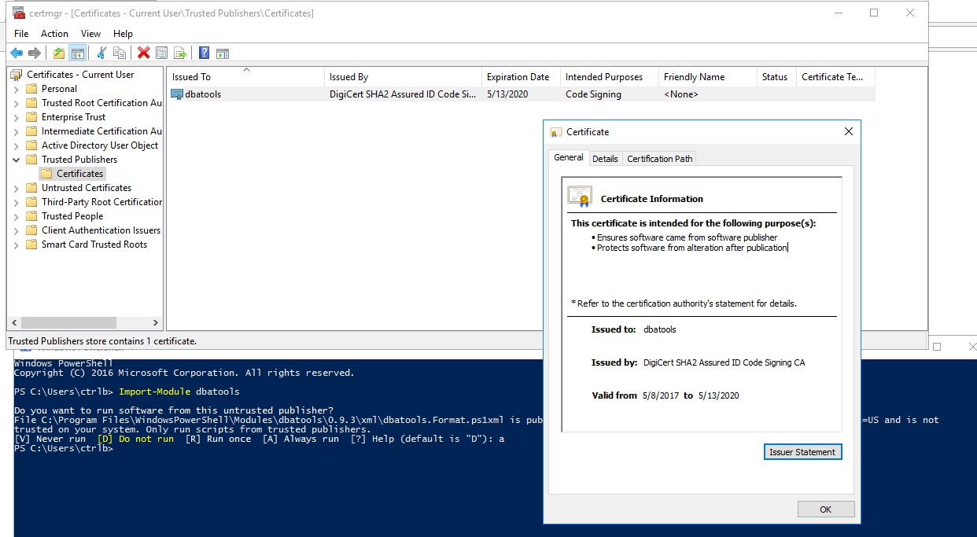
dbatools is digitally signed

Slide 39
Set-ExecutionPolicy
“Execution Policy is not a security control and should not be treated as one. The security control is Application Whitelisting (AppLocker / Device Guard)” ~ PowerShell Team
“It's important to understand that the setting was never meant to be a security control. Instead, it was intended to prevent administrators from shooting themselves in the foot.” ~ Scott Sutherland, author of PowerUpSQL
Notes:
https://blog.netspi.com/15-ways-to-bypass-the-powershell-execution-policy
https://www.darkoperator.com/blog/2013/3/5/powershell-basics-execution-policy-part-1.html
https://blogs.msdn.microsoft.com/powershell/2008/09/30/powershells-security-guiding-principles/
“ExecutionPolicy is like a baby door. The ExecutionPolicy keeps babies safe but every grown-up passes it easily.” ~ David das Neves, Microsoft PFE

Slide 40
For more information
dbatools.io/fullinstall

Slide 41
How to Get-Help
Extensive documentation within each command
Get-Help Start-DbaMigration -Detailed
Extensive documentation on dbatools.io
dbatools.io/Test-DbaLastBackup dbatools.io/Set-DbaSpn
Some commands have videos
dbatools.io/youtube

Slide 42
SqlServer vs dbatools
SqlServer is officially supported by Microsoft
SqlServer is C# cmdlet based
SqlServer is closed-source & must be fixed and enhanced by Microsoft
SqlServer has fewer resources
dbatools has unofficial, community-based support
dbatools is PowerShell function based
dbatools is open source – fix or enhance yourself or ask us
dbatools has 100+ contributors
Notes:
Mention that SqlServer is successor to SQLPS

Slide 43
demo time!
Notes:
# Set some vars
$new = "localhost\sql2016"
$old = $instance = "localhost"
$allservers = $old, $new
# Alternatively, use Registered Servers?
Get-DbaRegisteredServer -SqlInstance $instance | Out-GridView
# Quick overview of commands
Start-Process https://dbatools.io/commands
# You've probably heard about how easy migrations can be with dbatools. Here's an example
$startDbaMigrationSplat = @{
Source = $old
Destination = $new
BackupRestore = $true
NetworkShare = 'C:\temp'
NoSysDbUserObjects = $true
NoCredentials = $true
NoBackupDevices = $true
NoEndPoints = $true
}
Start-DbaMigration @startDbaMigrationSplat -Force | Select * | Out-GridView
# Use Ola Hallengren's backup script? We can restore an *ENTIRE INSTNACE* with just one line
Get-ChildItem -Directory \\workstation\backups\sql2012 | Restore-DbaDatabase -SqlInstance $new
# Nowadays, we don't just backup databases. Now, we're backing up logins
Export-DbaLogin -SqlInstance $instance -Path C:\temp\logins.sql
Invoke-Item C:\temp\logins.sql
# And Agent Jobs
Get-DbaAgentJob -SqlInstance $old | Export-DbaScript -Path C:\temp\jobs.sql
# What if you just want to script out your restore?
Get-ChildItem -Directory \\workstation\backups\subset\ | Restore-DbaDatabase -SqlInstance $new -OutputScriptOnly -WithReplace | Out-File -Filepath c:\temp\restore.sql
Invoke-Item c:\temp\restore.sql
# Complaint: Already have a library of Profiler templates
# Answer: Convert them instantly to Sessions (h/t Jonathan Kehayias)
Get-DbaTrace -SqlInstance sql2014 | ConvertTo-DbaXESession | Start-DbaXESession
# Easily import
Get-DbaXESessionTemplate | Out-GridView -PassThru | Import-DbaXESessionTemplate -SqlInstance $servers | Start-DbaXESession
# Testing your backups is crazy easy!
Start-Process https://dbatools.io/Test-DbaLastBackup
Test-DbaLastBackup -SqlInstance $old | Out-GridView
# But what if you want to test your backups on a different server?
Test-DbaLastBackup -SqlInstance $old -Destination $new | Out-GridView
# Know how snapshots used to be a PITA? Now they're super easy
New-DbaDatabaseSnapshot -SqlInstance $new -Database db1 -Name db1_snapshot
Get-DbaDatabaseSnapshot -SqlInstance $new
Get-DbaProcess -SqlInstance $new -Database db1 | Stop-DbaProcess
Restore-DbaFromDatabaseSnapshot -SqlInstance $new -Database db1 -Snapshot db1_snapshot
Remove-DbaDatabaseSnapshot -SqlInstance $new -Snapshot db1_snapshot # or -Database db1
# We evaluated 37,545 SQL Server stored procedures on 9 servers in 8.67 seconds!
$new | Find-DbaStoredProcedure -Pattern dbatools
# Have an employee who is leaving? Find all of their objects.
$allservers | Find-DbaUserObject -Pattern ad\jdoe | Out-GridView
# Find detached databases, by example
Detach-DbaDatabase -SqlInstance $instance -Database AdventureWorks2012
Find-DbaOrphanedFile -SqlInstance $instance | Out-GridView
# View and change service account
Get-DbaSqlService -ComputerName workstation | Out-GridView
Get-DbaSqlService -ComputerName workstation | Select * | Out-GridView
Get-DbaSqlService -Instance SQL2016 -Type Agent | Update-DbaSqlServiceAccount -Username 'Local system'
# Check out how complete our sp_configure command is
Get-DbaSpConfigure -SqlInstance $new | Out-GridView
Get-DbaSpConfigure -SqlInstance $new -ConfigName XPCmdShellEnabled
# Easily update configuration values
Set-DbaSpConfigure -SqlInstance $new -ConfigName XPCmdShellEnabled -Value $true
# XEs Read and watch
Get-DbaXESession -SqlInstance $new -Session system_health | Read-DbaXEFile
# Reset-DbaAdmin
Reset-DbaAdmin -SqlInstance $instance -Login sqladmin -Verbose
Get-DbaDatabase -SqlInstance $instance -SqlCredential (Get-Credential sqladmin)
# sp_whoisactive
Install-DbaWhoIsActive -SqlInstance $instance -Database master
Invoke-DbaWhoIsActive -SqlInstance $instance -ShowOwnSpid -ShowSystemSpids
# Diagnostic query!
$instance | Invoke-DbaDiagnosticQuery -UseSelectionHelper | Export-DbaDiagnosticQuery -Path $home
Invoke-Item $home
# Ola, yall
$instance | Install-DbaMaintenanceSolution -ReplaceExisting -BackupLocation C:\temp -InstallJobs
# Get db space AND write it to table
Get-DbaDatabaseFile -SqlInstance $instance | Out-GridView
Get-DbaDatabaseFile -SqlInstance $instance -IncludeSystemDB | Write-DbaDataTable -SqlInstance $instance -Database tempdb -Table DiskSpaceExample -AutoCreateTable
Invoke-DbaSqlcmd -ServerInstance $instance -Database tempdb -Query 'SELECT * FROM dbo.DiskSpaceExample' | Out-GridView
# History
Get-Command -Module dbatools *history*
# More histories
Get-DbaAgentJobHistory -SqlInstance $instance | Out-GridView
Get-DbaBackupHistory -SqlInstance $new | Out-GridView
# Test/Set SQL max memory
$allservers | Get-DbaMaxMemory
$allservers | Test-DbaMaxMemory | Format-Table
$allservers | Test-DbaMaxMemory | Where-Object { $_.SqlMaxMB -gt $_.TotalMB } | Set-DbaMaxMemory -WhatIf
Set-DbaMaxMemory -SqlInstance $instance -MaxMb 1023
# Reads trace files - default trace by default
Read-DbaTraceFile -SqlInstance $instance | Out-GridView
# don't have remoting access? Explore the filesystem. Uses master.sys.xp_dirtree
Get-DbaFile -SqlInstance $instance
Get-DbaFile -SqlInstance $instance -Depth 3 -Path 'C:\Program Files\Microsoft SQL Server' | Out-GridView
New-DbaSqlDirectory -SqlInstance $instance -Path 'C:\Program Files\Microsoft SQL Server\MSSQL14.MSSQLSERVER\test'
# Out-GridView madness <3
Get-DbaDatabase -SqlInstance $old | Out-GridView -PassThru | Copy-DbaDatabase -Destination $new -BackupRestore -NetworkShare \\workstation\c$\temp -Force
# We've even got our own config system!
Get-DbaConfig | Out-GridView
# Check out our logs directory, so Enterprise :D
Invoke-Item (Get-DbaConfig -FullName path.dbatoolslogpath).Value
# Want to see what's in our logs?
Get-DbatoolsLog | Out-GridView
# Need to send us diagnostic information? Use this support package generator
New-DbatoolsSupportPackage

Slide 44

SQL Server
Pester
❤️

Slide 45
TODAY’s TO DO LIST
GET UP
Drink Appropriate Liquid
The Rest

Slide 46
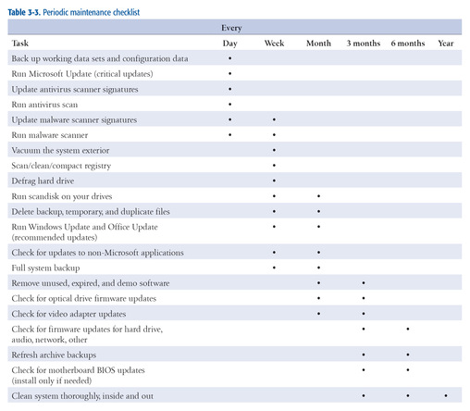
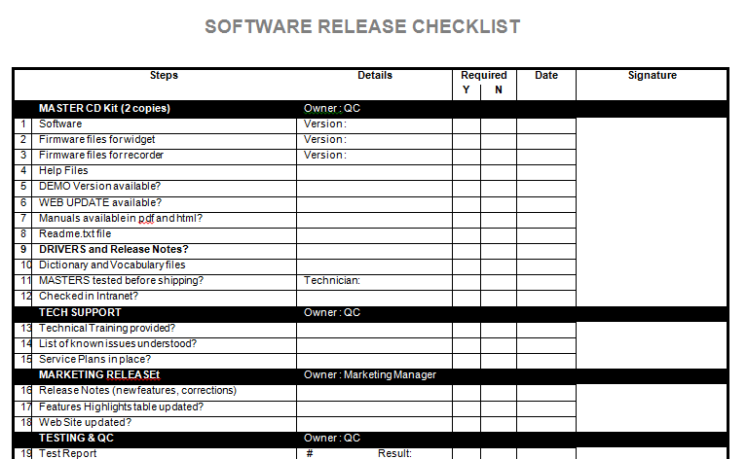
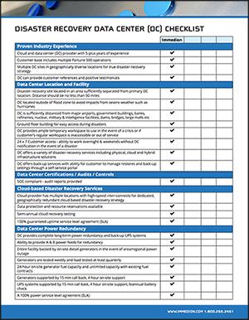
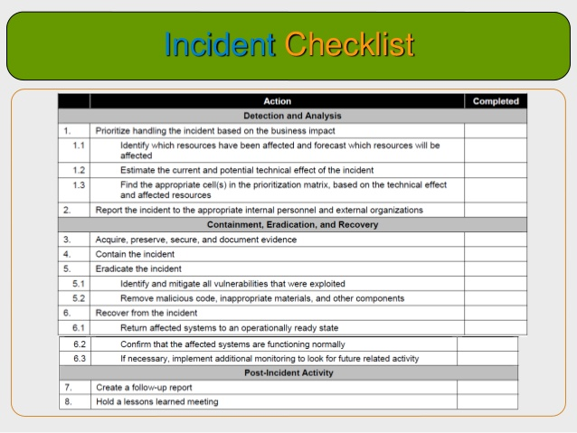
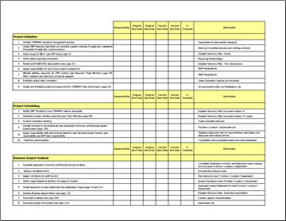
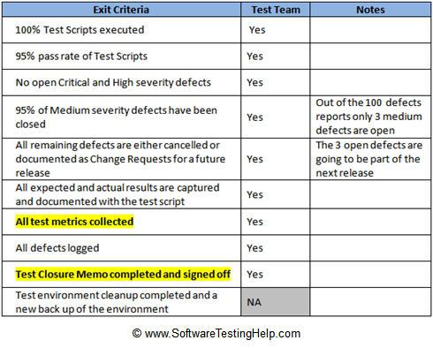
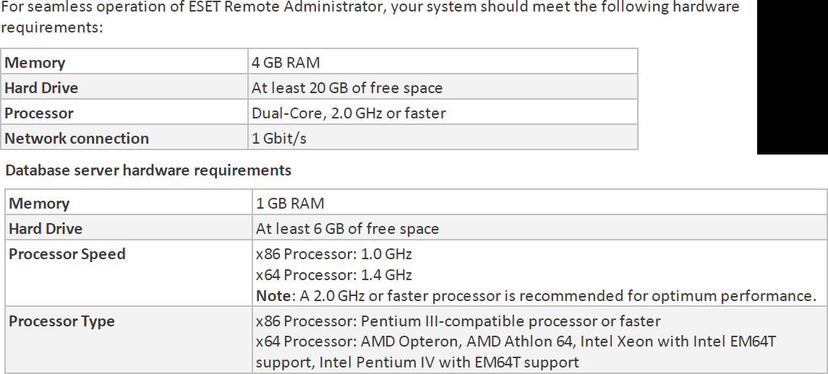
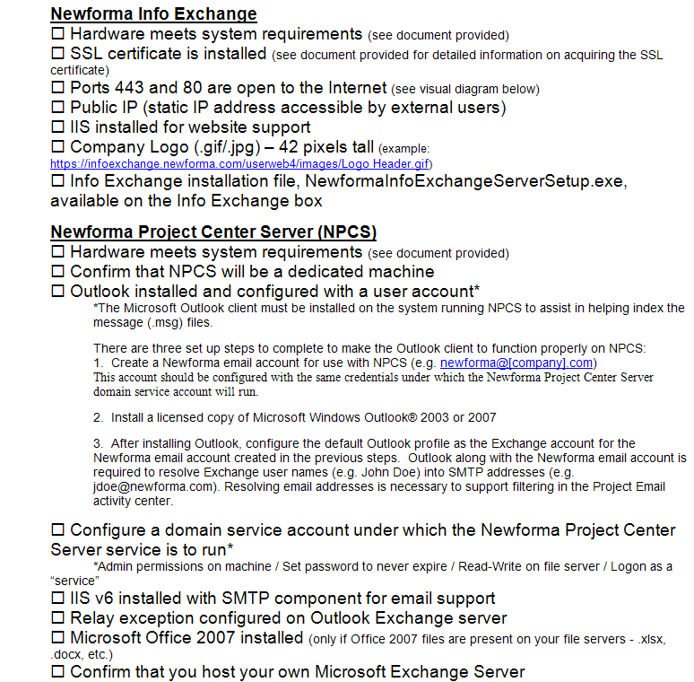
How many checklists do you have?
Notes:
I bet there are checklists for
New servers/ data centers
Hardware/software installations
Incident Response
1st Line/2nd line for systems
Pre-requisites
Morning routines

Slide 47
What about
Demos
Presentations
Morning Checks
Incident Response
First Line Support
I‘m sure you are already thinking of more

Slide 48
What is Pester?
Pester provides a framework for running unit tests to execute and validate PowerShell commands from within PowerShell
sqlps.io/pester
Notes:
Its used for unit testing or TDD but can also be used to validate an environment.
Comes with Windows 10 or install from the gallery with Install-Module Pester

Slide 49
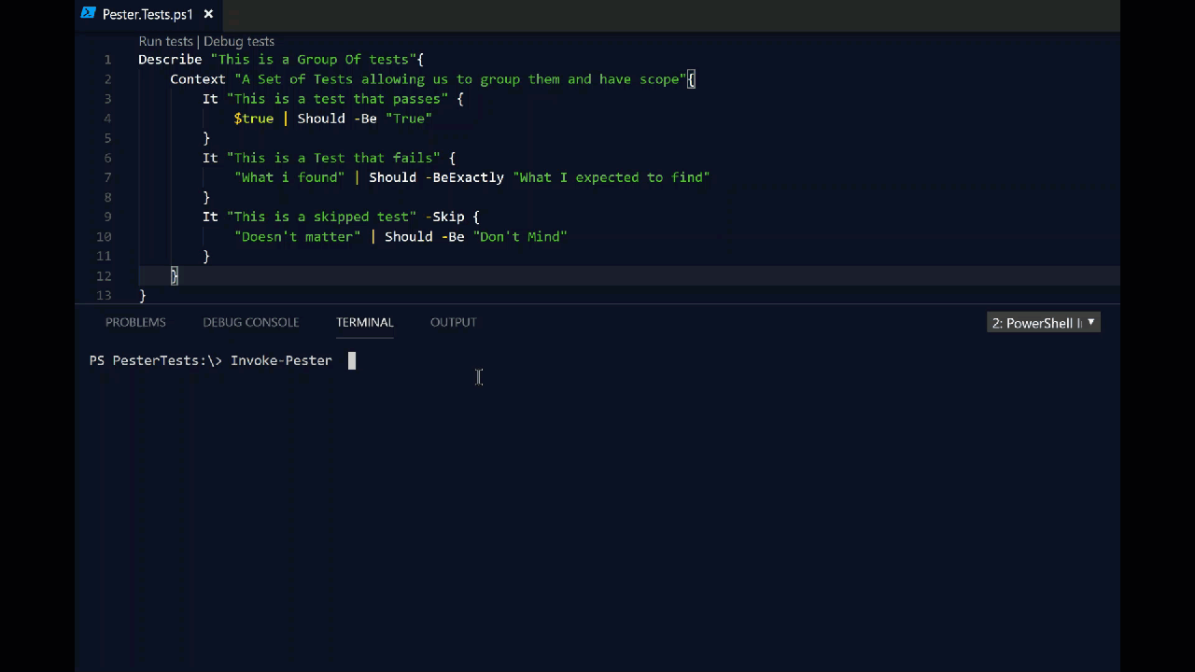
What Does Pester Look Like?
Notes:
This is a Pester test running in VS Code

Slide 50

Apologies. Forgive Me!

Slide 51
Should Operators – Part 1
-Be Compares one object with another for equality. Case Insensitive -BeExactly Compares one object with another for equality. Case Sensitive -BeGreaterThan Asserts that a number is greater than an expected value. -BeLessThan Asserts that a number is less than an expected value.
-BeIn Asserts that the actual value is contained by the array/collection -BeLike Matches a wildcard pattern using -like operator. Case Insensitive -BeLikeExactly Matches a wildcard pattern using -like operator. Case Sensitive -BeOfType Asserts that the actual value should be an object of a specified type -Exist Checks if the object calling Exist is present in a PS Provider. -FileContentMatch Checks to see if a file contains the specified text. Case Insensitive
-FileContentMatchExactly Checks to see if a file contains the specified text. Case Sensitive -ContainExactly Checks to see if a file contains the specified text. Case Sensitive -Match Uses a regular expression to compare two objects. Case Insensitive -MatchExactly Uses a regular expression to compare two objects. Case Sensitive -Throw Checks if an exception was thrown in the input ScriptBlock. -BeNullOrEmpty Checks values for null or empty (strings).
I hate slides with lots of text but I think this one is valid
Notes:
For you to use in the future – The important one to remember is the contains

Slide 52
Should Operators – Part 2
-Be Compares one object with another for equality. Case Insensitive -BeExactly Compares one object with another for equality. Case Sensitive -BeGreaterThan Asserts that a number is greater than an expected value. -BeLessThan Asserts that a number is less than an expected value.
-BeIn Asserts that the actual value is contained by the array/collection -BeLike Matches a wildcard pattern using -like operator. Case Insensitive -BeLikeExactly Matches a wildcard pattern using -like operator. Case Sensitive -BeOfType Asserts that the actual value should be an object of a specified type -Exist Checks if the object calling Exist is present in a PS Provider. -FileContentMatch Checks to see if a file contains the specified text. Case Insensitive
-FileContentMatchExactly Checks to see if a file contains the specified text. Case Sensitive -ContainExactly Checks to see if a file contains the specified text. Case Sensitive -Match Uses a regular expression to compare two objects. Case Insensitive -MatchExactly Uses a regular expression to compare two objects. Case Sensitive -Throw Checks if an exception was thrown in the input ScriptBlock. -BeNullOrEmpty Checks values for null or empty (strings).
I hate slides with lots of text but I think this one is valid
Notes:
For you to use in the future – The important one to remember is the contains

Slide 53
Should Operators – Part 2
Not -Be Compares one object with another for equality. Case Insensitive Not -BeExactly Compares one object with another for equality. Case Sensitive Not -BeGreaterThan Asserts that a number is greater than an expected value. Not -BeLessThan Asserts that a number is less than an expected value.
Not -BeIn Asserts that the actual value is contained by the array/collection Not -BeLike Matches a wildcard pattern using -like operator. Case Insensitive Not -BeLikeExactly Matches a wildcard pattern using -like operator. Case Sensitive Not -BeOfType Asserts that the actual value should be an object of a specified type Not -Exist Checks if the object calling Exist is present in a PS Provider. Not -FileContentMatch Checks to see if a file contains the specified text. Case Insensitive
Not -FileContentMatchExactly Checks to see if a file contains the specified text. Case Sensitive Not -ContainExactly Checks to see if a file contains the specified text. Case Sensitive Not -Match Uses a regular expression to compare two objects. Case Insensitive Not -MatchExactly Uses a regular expression to compare two objects. Case Sensitive Not -Throw Checks if an exception was thrown in the input ScriptBlock. Not -BeNullOrEmpty Checks values for null or empty (strings).
Every Should can be Should Not
I hate slides with lots of text but I think this one is valid
Notes:
For you to use in the future – The important one to remember is the contains

Slide 54

So what can you validate ?
Notes:
Everything in the world ☺

Slide 55
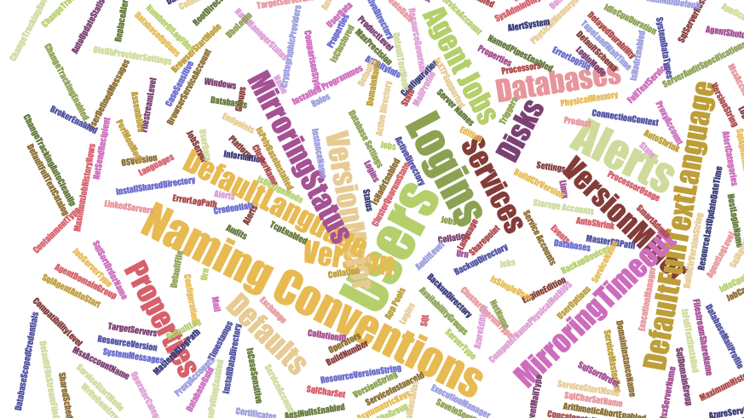
Maybe not EVERYthing!
but anything you can validate with PowerShell
Notes:
These are just some of the properties of
A SQL Server SMO object,
A Job Server object and
A database object
There are (for SQL Server 2017
113 properties on a SQL Server Instance object
75 on a Configuration object
184 properties ona Database object
47 on a Job Server object
40 on a Job Object
AND That’s just SQL Server – Files, Operating System, Active Directory etc etc etc

Slide 56
Maybe not EVERYTHING – Part 2
Which Does NOT include
Describe “Bag Packing” {
Context “Hardware”{
It “Bag Contents Should include BeardNUC” {
‘beardnuc’| Should –BeIn $bag.Contents
}
}
}
I had no virtual machines with me Queue demo re-write until 3am!
Notes:
Whilst this is a funny slide there is an important piece of Pester knowledge here

Slide 57

Hey Beardy!
DEMO
Time

Slide 58
Summary
We all have checklists – manual testing is error-prone
Pester is a Unit Testing Framework for PowerShell
You can use it to validate your infrastructure
The basic syntax - Describe, Context and It code blocks
The Should command is used for testing assertions
Use the NunitXML output, export to JSON and use PowerBi for fantastic reports or to be consumed in your CI/CD process

Slide 59

Lunch

Slide 60
Sqlps.io/sqlbitspptx

Slide 61
Writing Pester Tests

Slide 62
Pester for DBA’s – Quick Recap
Validation that our estate is as we expect it to be
PowerShell over T-SQL as it is easier to access
Multiple Instances
Active Directory
File System
Registry
Many more things easier!
Notes:
Pester enables validation that our Instances are as we expect them to be
The beauty of using PowerShell over T-SQL is that PowerShell can easily access more properties from other providers – Azure, Active Directory, File System, DNS, Registry etc

Slide 63
Pester for Developers
“Even though we are Operations, because we are writing scripts that others will use, we are now developers as well. We need to understand that TDD is a better way of writing good quality code and enabling us to follow good practices”
Some Bearded Fellow throughout 2017

Slide 64



Pester for Audits & Regulations
DISA STIG
GDPR
CIS
Notes:
Defense Information Systems Agency
Security Technical Implementation Guides
EU General Data Protection Regulation
Center for Internet Security
Pester can also be used for simplifying audits such as those required by DISA, CIS and GDPR. Imagine as a DBA, having 50 servers with 1000 databases. And each of these servers may be subject to up to 300 checks each. That's nearly 300,000 checks total! Recently, I went through an audit and initially, kept track of each pass/fail manually. I'd check my servers with PowerShell, then write down each of the failures that had to be documented or remediated.
It was exhausting.
But after I thought about it, I realized that Pester would be perfect to not only keep track of these checks for my immediate needs, but on an ongoing basis as well. So in this way, using Pester can keep you more secure by helping to ensure long-term compliance.
Not only that, it looks super impressive! I was so exciting seeing all this green fly by, that I showed my boss, the IA team and even the auditors. And while the auditors did not accept the results without manual checks, they were chuffed that a random DBA had this cool tool to help ensure compliance. So basically, you can impress your friends, your boss, auditors and even executive management - all with Pester (and you can even add in a sprinkle of PowerBI to make the results clickable and beautiful).

Slide 65
Crowdsourced Test Writing

Slide 66
Todo
Decide the information you wish to test
Understand how to get it with PowerShell
Understand what makes it pass or fail
Write the test

Slide 67

tools we use
and how we use them, all free

Slide 68

VSTS
Visual Studio Team Services

Slide 69
For more information
sqlps.io/vsts

Slide 70

AppVeyor

Slide 71

AppVeyor
Continuous Integration solution for Windows
Often used by PowerShell projects
Fast build VMs with pre-installed software
Free for OSS

Slide 72
AppVeyor is essential to our build process
Starts 4 VMs with pre-installed SQL Server instances
SQL Server 2008 R2
SQL Server 2016
SQL Server 2016 for restart/update commands
SQL Server 2016 + 2008 R2 for migration commands
Ensures standards – help, tab-indented, trailing spaces
dbatools.io/ci and dbatools.io/tests

Slide 73

Power BI

Slide 74

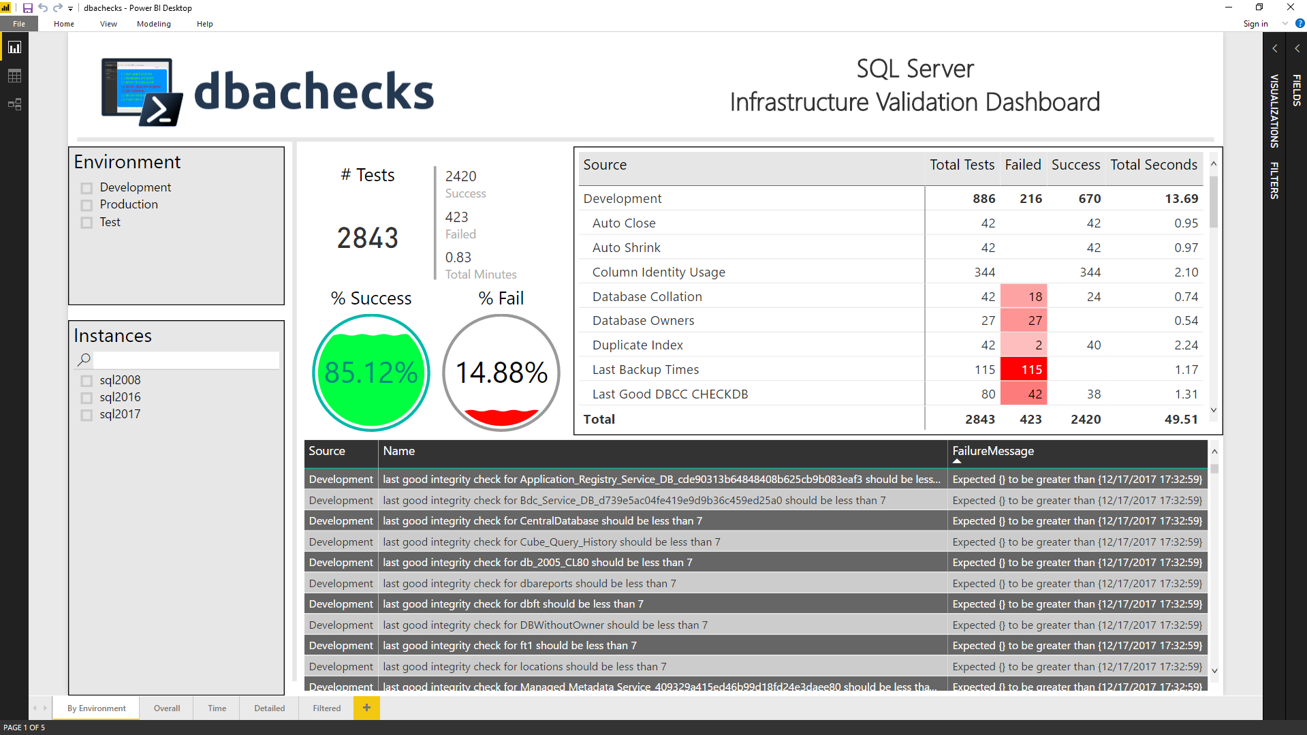
Dashboards galore

Slide 75
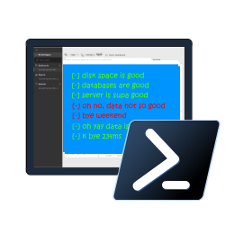
Introducing dbachecks
the new community module

Slide 76
Blog posts & Twitter
dbachecks.io/intro
dbachecks.io/deepdive
dbachecks.io/blog
dbachecks.io/twitter

Slide 77
System Requirements
MINIMUM
RECOMMENDED
Client
PowerShell v4
Modules
dbatools
Pester
PSFramework
Client
PowerShell v5.1

Slide 78
Install is easy
POWERSHELL GALLERY
Install-Module dbachecks
Install-Module dbachecks –Scope CurrentUser
* Automatically installs required modules

Slide 79
Need an offline install?
POWERSHELL GALLERY FROM CONNECTED WORKSTATION
Save-Module dbachecks, dbatools, Pester, PSFramework

Slide 80
demo time!
Notes:
# To get started
Install-Module Pester -SkipPublisherCheck
Update-Module Pester -Force
Import-Module Pester -Force
# Perform a basic check
Invoke-DbcCheck -SqlInstance localhost\sql2017 -Checks SuspectPage, LastBackup
# How do we know which checks exist and if we should specify SqlInstance or ComputerName?
Get-DbcCheck | Out-GridView
Get-DbcCheck *disk*
Invoke-DbcCheck -SqlInstance localhost\sql2017 -Checks ValidDatabaseOwner
# Make a server list
$servers = "localhost\sql2017","localhost\sql2016"
$servers = Get-DbaRegisteredServer -SqlInstance localhost\sql2017
$servers = Get-Content C:\scripts\servers.txt
$servers = Get-ADComputer -Filter "name -like '*sql*'"
# Run statically - set once
Set-DbcConfig -Name app.sqlinstance -Value $servers
Set-DbcConfig -Name app.computername -Value localhost
Invoke-DbcCheck -Checks SuspectPage, LastBackup
Invoke-DbcCheck -Checks DiskCapacity
# Or Dynamically
Invoke-DbcCheck -SqlInstance $sqlservers -Checks SuspectPage, LastBackup
Invoke-DbcCheck -ComputerName $computers -Checks DiskCapacity
# How do we know which configs exist?
Get-DbcConfig | Out-GridView
# A little more advanced which runs all Database Checks except backups - also passes an alternative credential
Invoke-DbcCheck -Check Database -ExcludeCheck Backup -SqlInstance localhost\sql2016 -SqlCredential (Get-Credential sqladmin)
# Run checks and export its JSON
Invoke-DbcCheck -SqlInstance localhost\sql2017 -Checks SuspectPage, LastBackup -Show Summary -PassThru |
Update-DbcPowerBiDataSource
# You can also split it up by environment
Invoke-DbcCheck -SqlInstance $prod -Checks LastBackup -Show Summary -PassThru | Update-DbcPowerBiDataSource -Environment Production
Invoke-DbcCheck -SqlInstance $dev -Checks LastBackup -Show Summary -PassThru | Update-DbcPowerBiDataSource -Environment Development
Invoke-DbcCheck -SqlInstance $test -Checks LastBackup -Show Summary -PassThru | Update-DbcPowerBiDataSource -Environment Test
# Launch Power BI then hit refresh
Start-DbcPowerBi
# Prefer email? Also easy:
Invoke-DbcCheck -SqlInstance localhost\sql2017 -Checks SuspectPage, LastBackup -OutputFormat NUnitXml -PassThru |
Send-DbcMailMessage -To clemaire@dbatools.io -From nobody@dbachecks.io -SmtpServer localhost
# Have specific requirements and want to add your own checks? Add your own repo! *
Set-DbcConfig -Name app.checkrepos -Value C:\temp\checks -Append
# What does our repo look like?
Invoke-Item "$(Split-Path (Get-Module dbachecks).Path)\checks"
Start-Process https://dbachecks.io/wiki
# Set a global, persistent credential
Set-DbcConfig -Name app.sqlcredential -Value (Get-Credential sqladmin)

Slide 81

Questions!

Slide 82
Thank you!

Slide 83
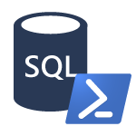
PowerShell & SQL Agent

Slide 84
PowerShell & the SQL Server Agent
PowerShell Job Step
sqlps.exe
Version varies by SQL Server version
Doesn’t always work as expected
CmdExec Job Step
powershell.exe via cmd.exe
Version is always the system version
Often (always?) works as expected
Notes:
FileSystem::\\UNC

Slide 85
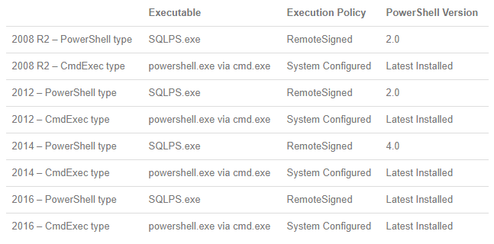
PowerShell & the SQL Server Agent
Thanks to Derik Hammer for this chart!
Notes:
https://www.sqlhammer.com/running-powershell-in-a-sql-agent-job/

Slide 86
PowerShell & the SQL Server Agent
Create a Windows-based Login in SQL Server
Ensure dbatools is available to the account
Create a SQL Server credential
Create the Agent Proxy
Create the PowerShell .ps1 file
Create the Job and Job Step
Schedule the Job

Slide 87
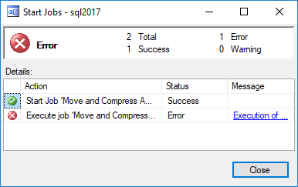
Ensure failed jobs fail
To ensure a job fails, throw a terminating exception
In dbatools, use –EnableException
In most PowerShell commands, use try/catch with –ErrorAction Stop

Slide 88
PowerShell & the SQL Server Agent
dbatools.io/agent

Slide 89
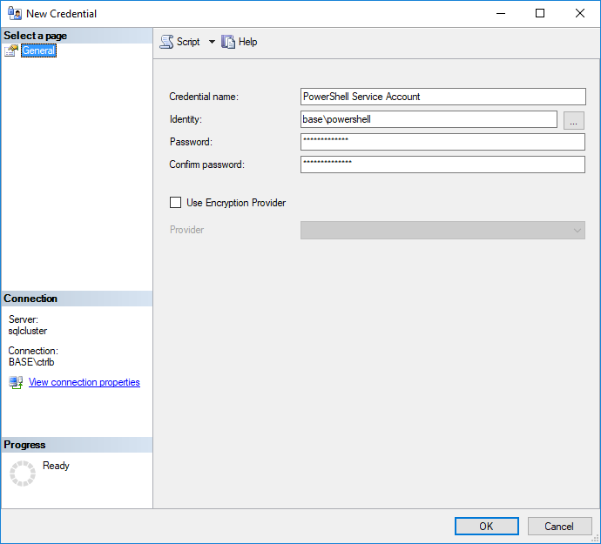
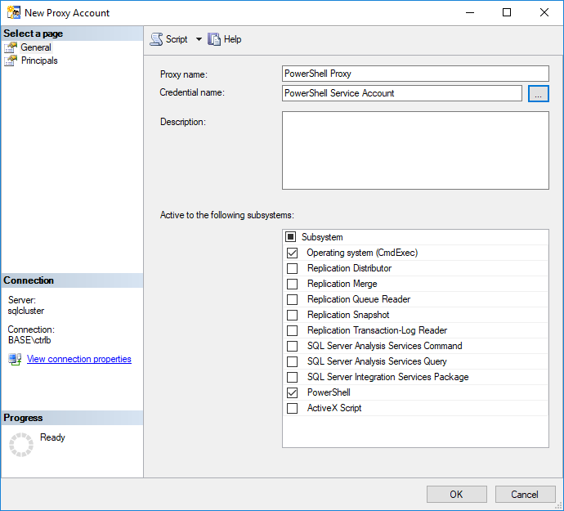
PowerShell & the SQL Server Agent

Slide 90
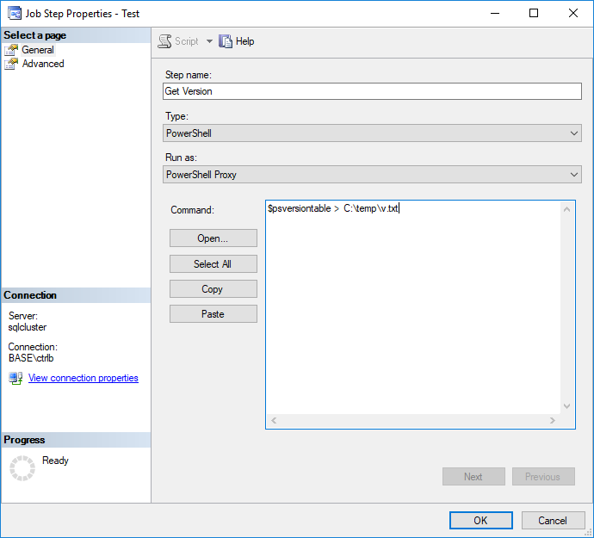
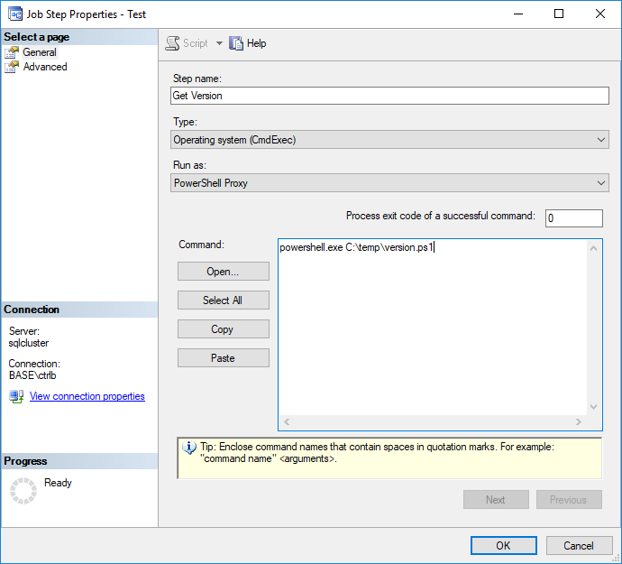
PowerShell & the SQL Server Agent

